Slide 1

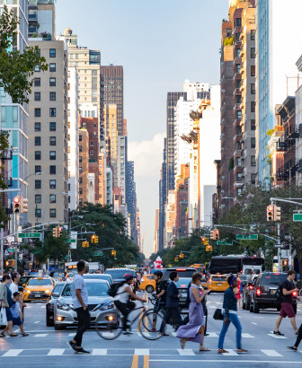
New York Motor Vehicle Crash Analysis
Najmeh Dehghani
David Garcia
November 2019

Slide 2
Motor vehicle crashes are the leading cause of death related injuries for New York State Residents. In order to improve it we need to know the major cause effects:
Which Day of the week and what time of the day the most crashes happened?
In which area most crashes happened ?

Slide 3
Scope: Analyzing state of New York Crashes for 2014,2015 & 2016
Najmeh Dehghani
David Garcia
Analyze the crashes in Data set based on :
Day of the week
Time during the Day
Compare the results for all three Years(2014,2015,2016)
Visualizing the comparison
Compare urban vs rural crashes
Indicate where the most crashes happened
Visualizing the number of crashes based on the county
Root Cause Analysis
Offer solutions

Slide 4


Data analysis process

Slide 5
Data Clean Up
Convert the objects to int
Convert the time and date to datetime
Create the bin to label the Day to 5 groups:
Early morning. Morning, Afternoon, Evening and Night
David

Slide 6
Day of the week:
Year | Day of Week | Percentage
2016 | Friday | 16.59
 | Thursday | 15.12
 | Tuesday | 15.01
 | Wednesday | 14.54
 | Monday | 14.42
 | Saturday | 13.18
 | Sunday | 11.15
2015 | Friday | 16.41
 | Thursday | 15.02
 | Wednesday | 14.75
 | Tuesday | 14.65
 | Monday | 14.33
 | Saturday | 13.24
 | Sunday | 11.59
2014 | Friday | 16.45
 | Wednesday | 15.23
 | Thursday | 15.18
 | Tuesday | 14.52
 | Monday | 14.31
 | Saturday | 13.32
 | Sunday | 10.99
This section we are analyzing and comparing the Percentage of the crashes based on day of the week
For each Year

Slide 7
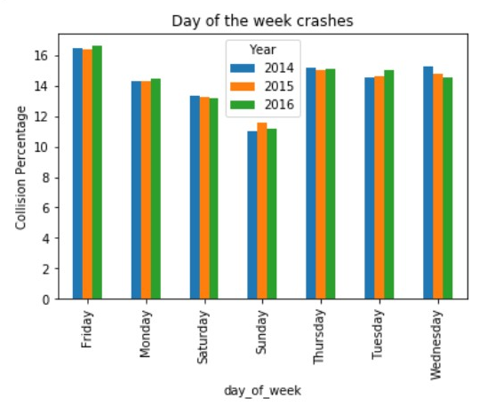
Visualization:

Slide 8
Time During the Day:
Crash Time | 2014 | 2015 | 2016
Early Morning | % 9.04 | % 8.73 | % 9.28
Morning | % 29.55 | % 29.29 | % 29.74
Afternoon | % 39.33 | % 39.48 | % 40.22
Evening | % 8.27 | % 7.96 | % 8.31
Night | % 8.25 | % 7.51 | % 7.96
We can see the comparison of the crashes based on the time happened during the day

Slide 9
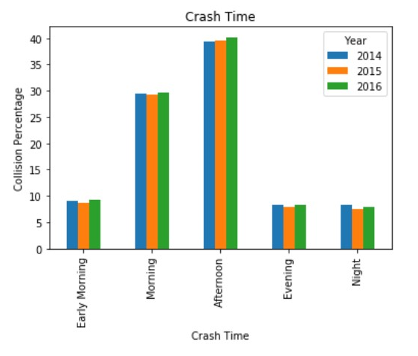
Visualization:

Slide 10
Conclusions and suggestion:
The most crashes happened on Friday evening
The highest percentage is related to Rush hours
We may need to include the schools and companies work schedule into consideration to facilitate decision making
The most crashes happened on Region or county(David)

Slide 11
supportive analysis
Weather Condition
Road surface condition
Seasons and months

Slide 12
Trends from the Data
Is there a trend across the 3 years of data?
Which Municipalities have the highest accident counts?
Was there a significant difference from one year to the other?
Which 5 municipalities continue to have the highest accidents per year?

Slide 13
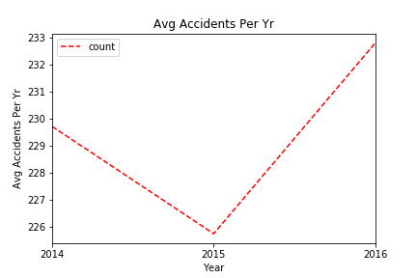
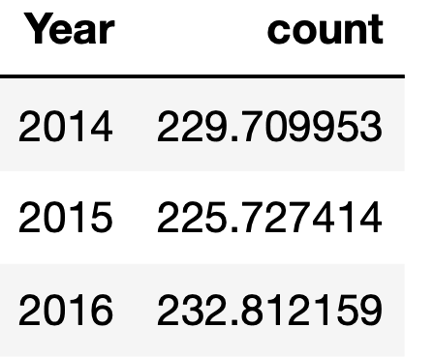
Average Accidents Per Year

Slide 14
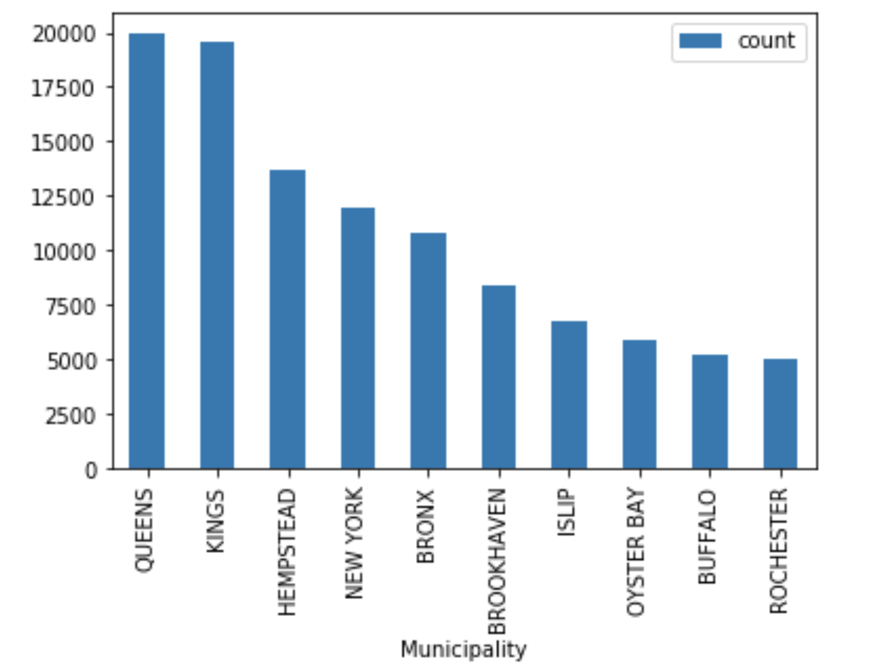
Highest Accident Count by Municipality
Queens has the most accidents across all years
Kings is a close second
Buffalo & Rochester round up the top 10

Slide 15
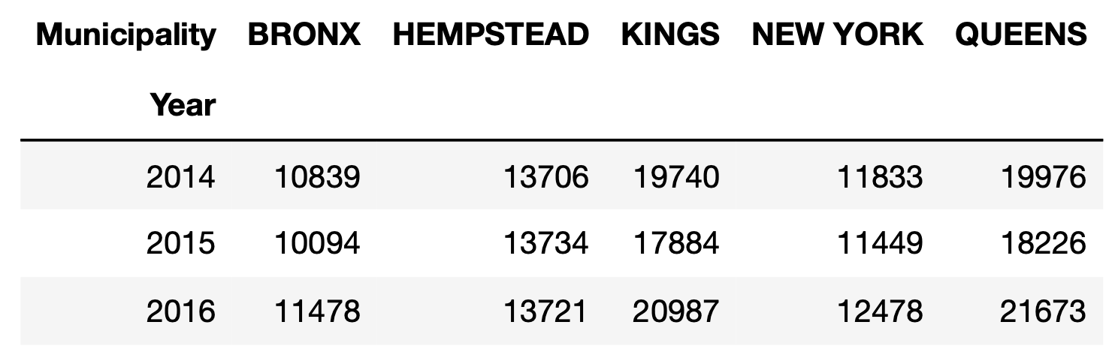
Most Accidents Per Municipality
5 Municipalities are very similar in total accidents per year

Slide 16
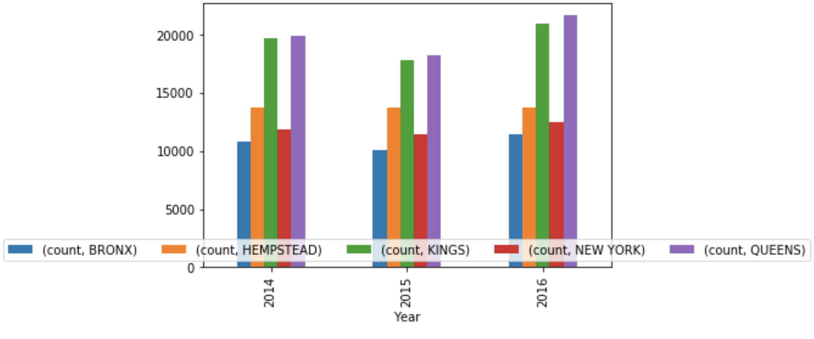
Accidents per Municipality per Year

Slide 17
Findings & Suggestions
There is really no significant difference in the number of accidents per year
Despite the slight decline in 2015, accidents in 2016 rose again
There is a consistency in which municipalities have the highest amount of accidents
Best practices in the municipalities with lower accident count could help the rest of the state

Slide 18

Question?

